Slide 1

TortoiseGit
Teacher: Omar Ali Zatarain Dúran
Course: Software Configuration Management
Author: Francisco Ismael López Gómez

Slide 2
Content
What is TortoiseGit?
Create Repository
Save Modifications
Login with you credentials
Add Link of you Repository
Modifications saved
The changes are reflect of online repository
View modification history
References

Slide 3
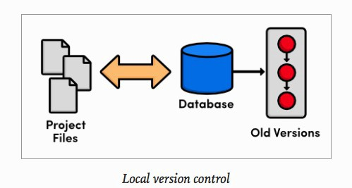
What is TortoiseGit?
TortoiseGit is an open source Git client. It is responsible for managing files stored in a local repository over time [1].
Allows you to recover previous versions of one or more files
The changes are also reflected in the online report
You can see who modified what file, when and how

Slide 4
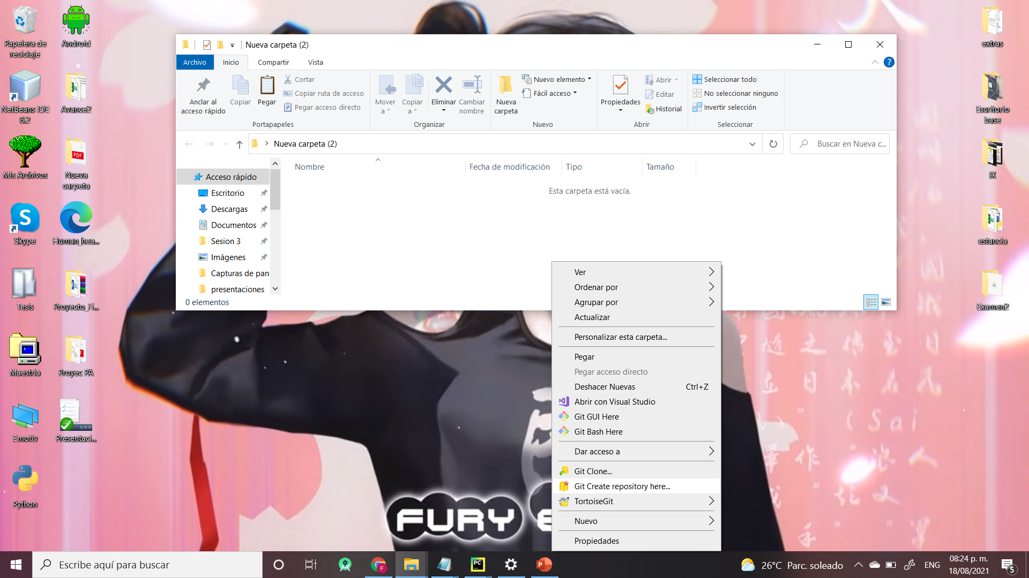
Create Repository

Slide 5
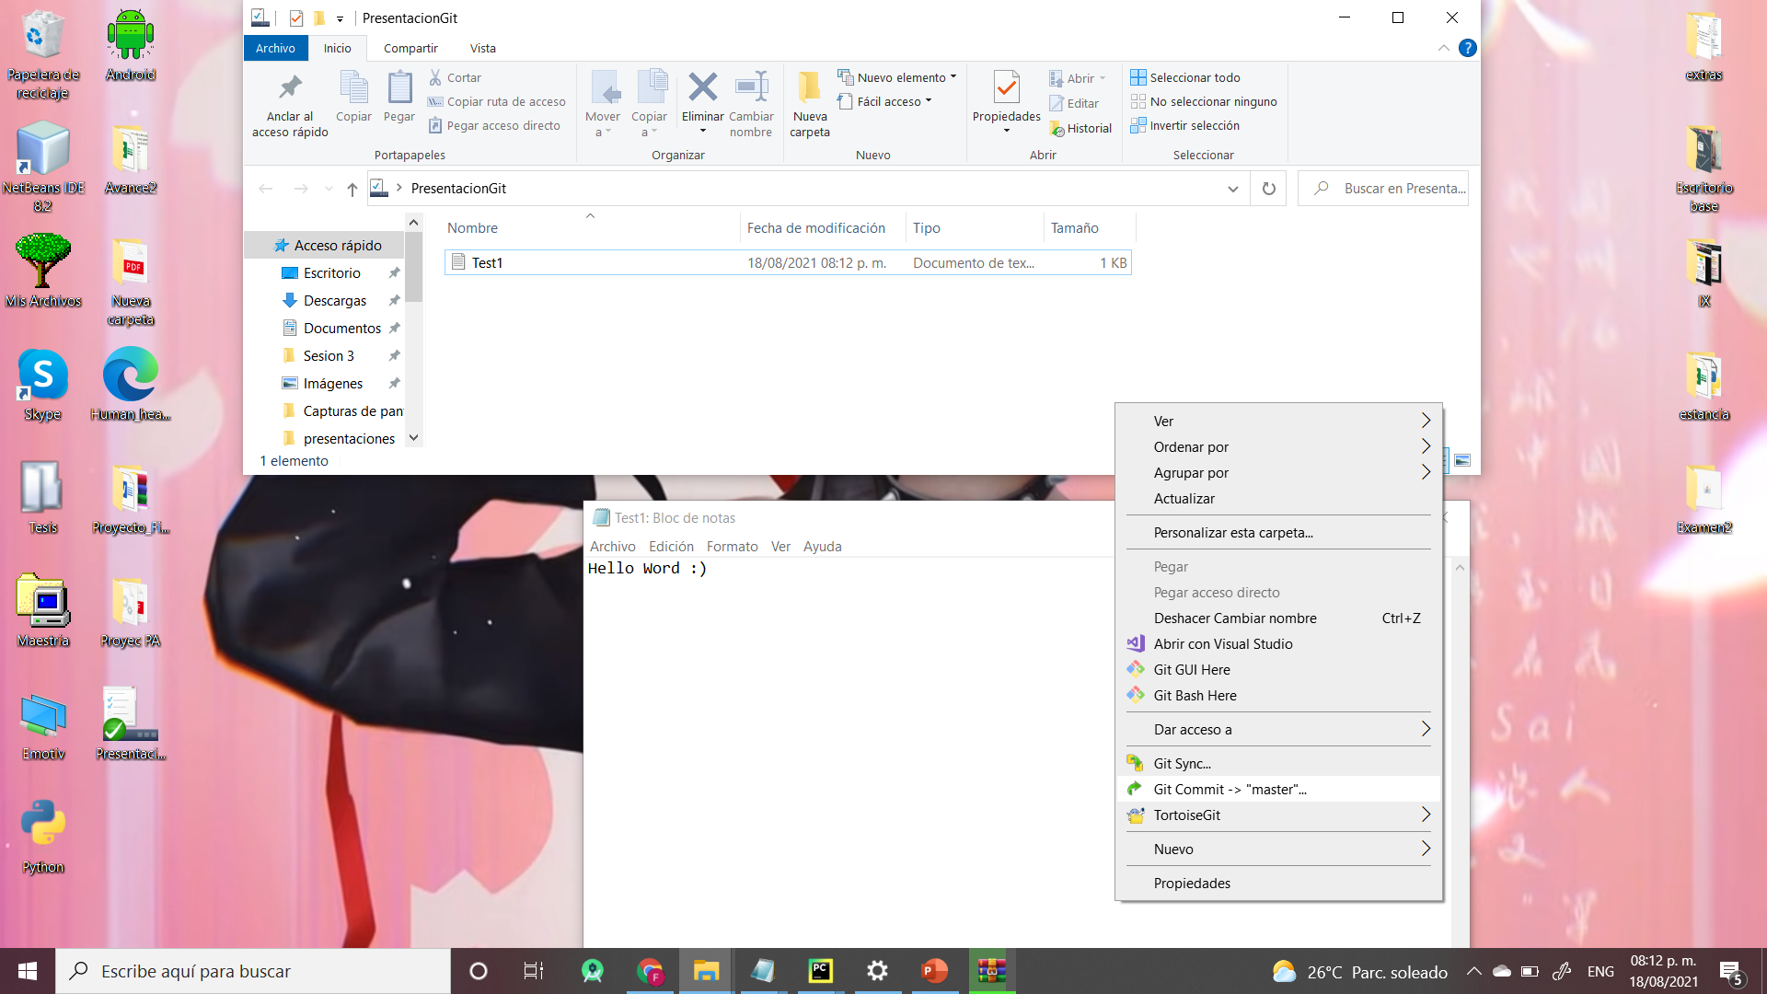
Save modifications

Slide 6
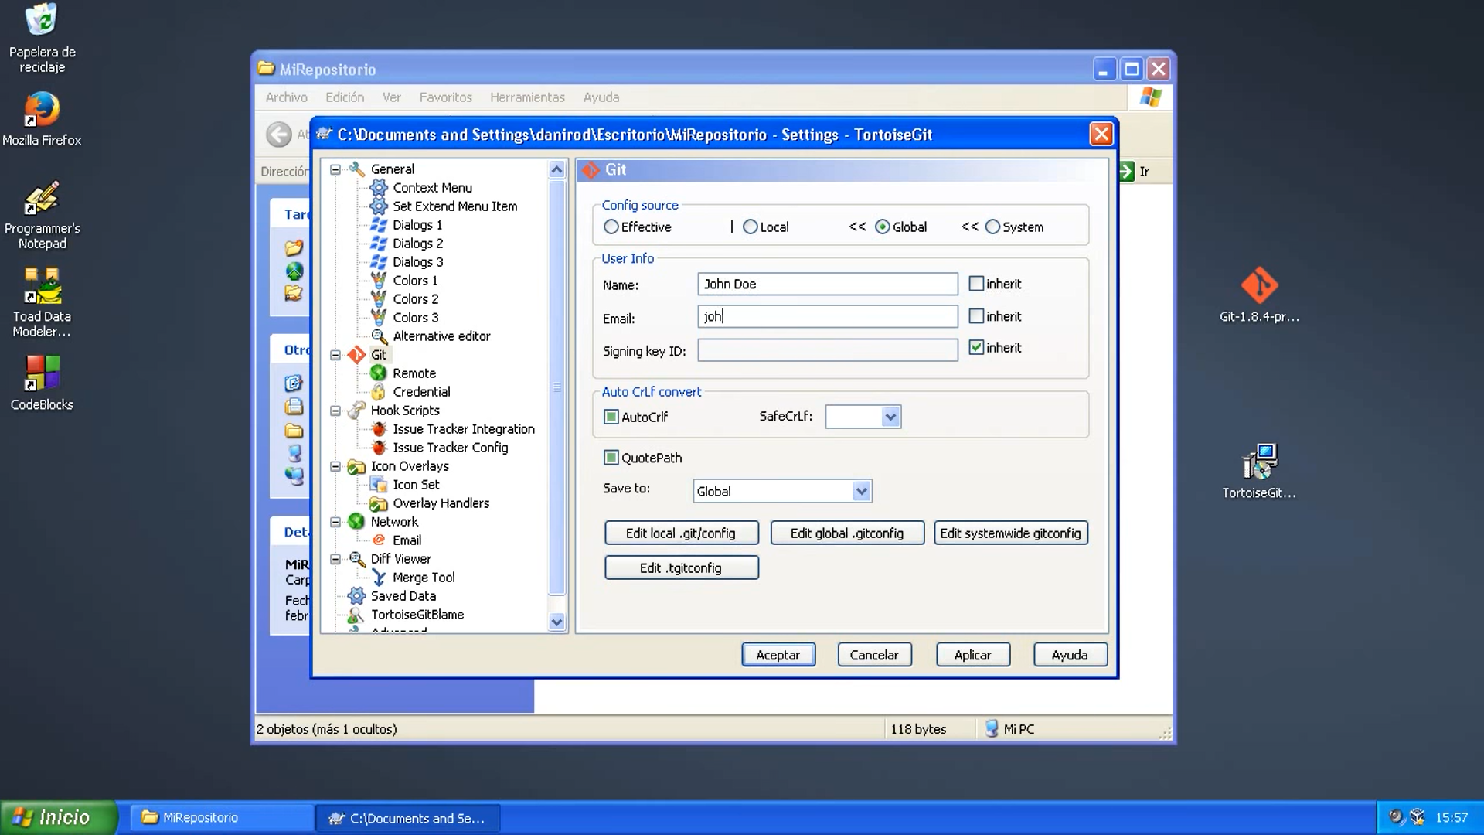
Login with you credentials

Slide 7
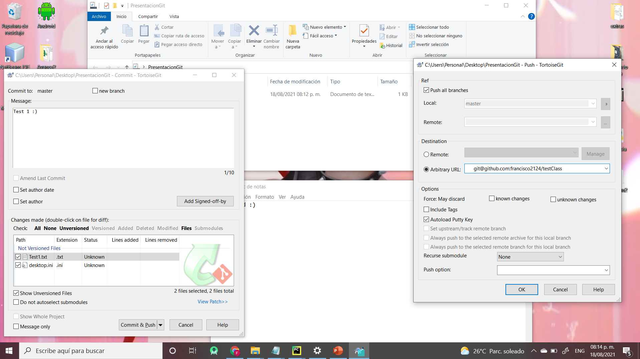
Add link of you repository

Slide 8
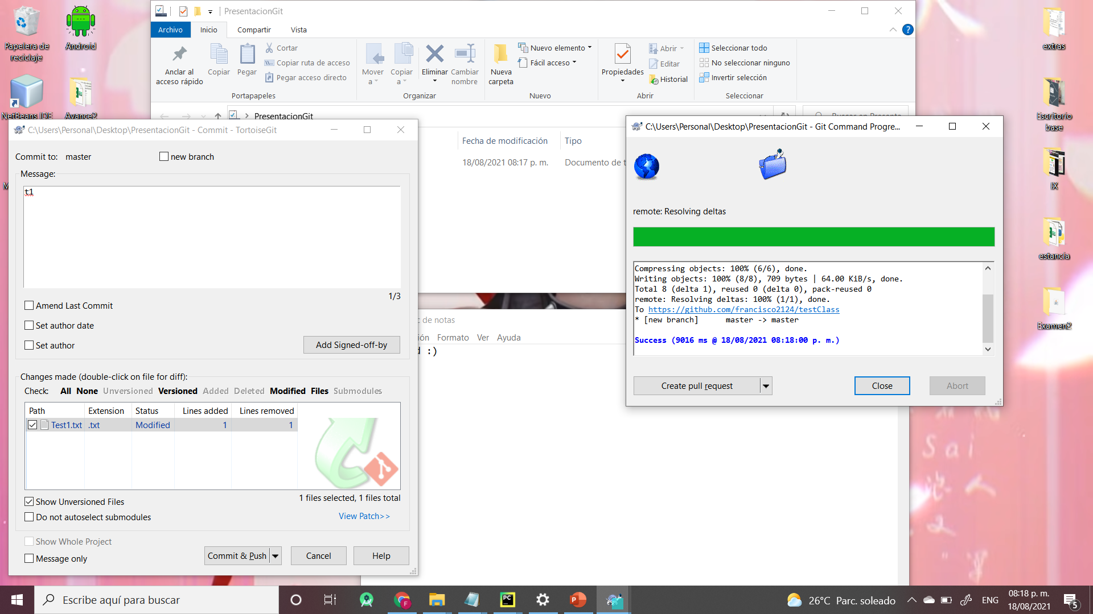
Modifications saved

Slide 9
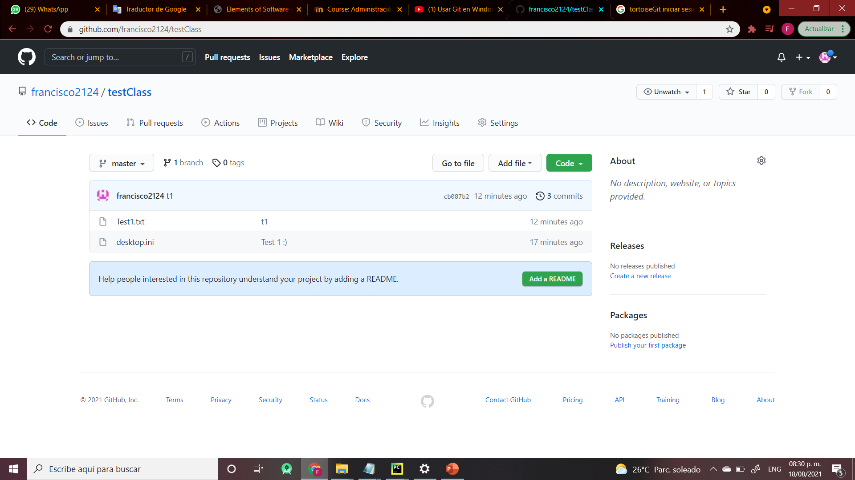
The changes are reflect in the online repository

Slide 10
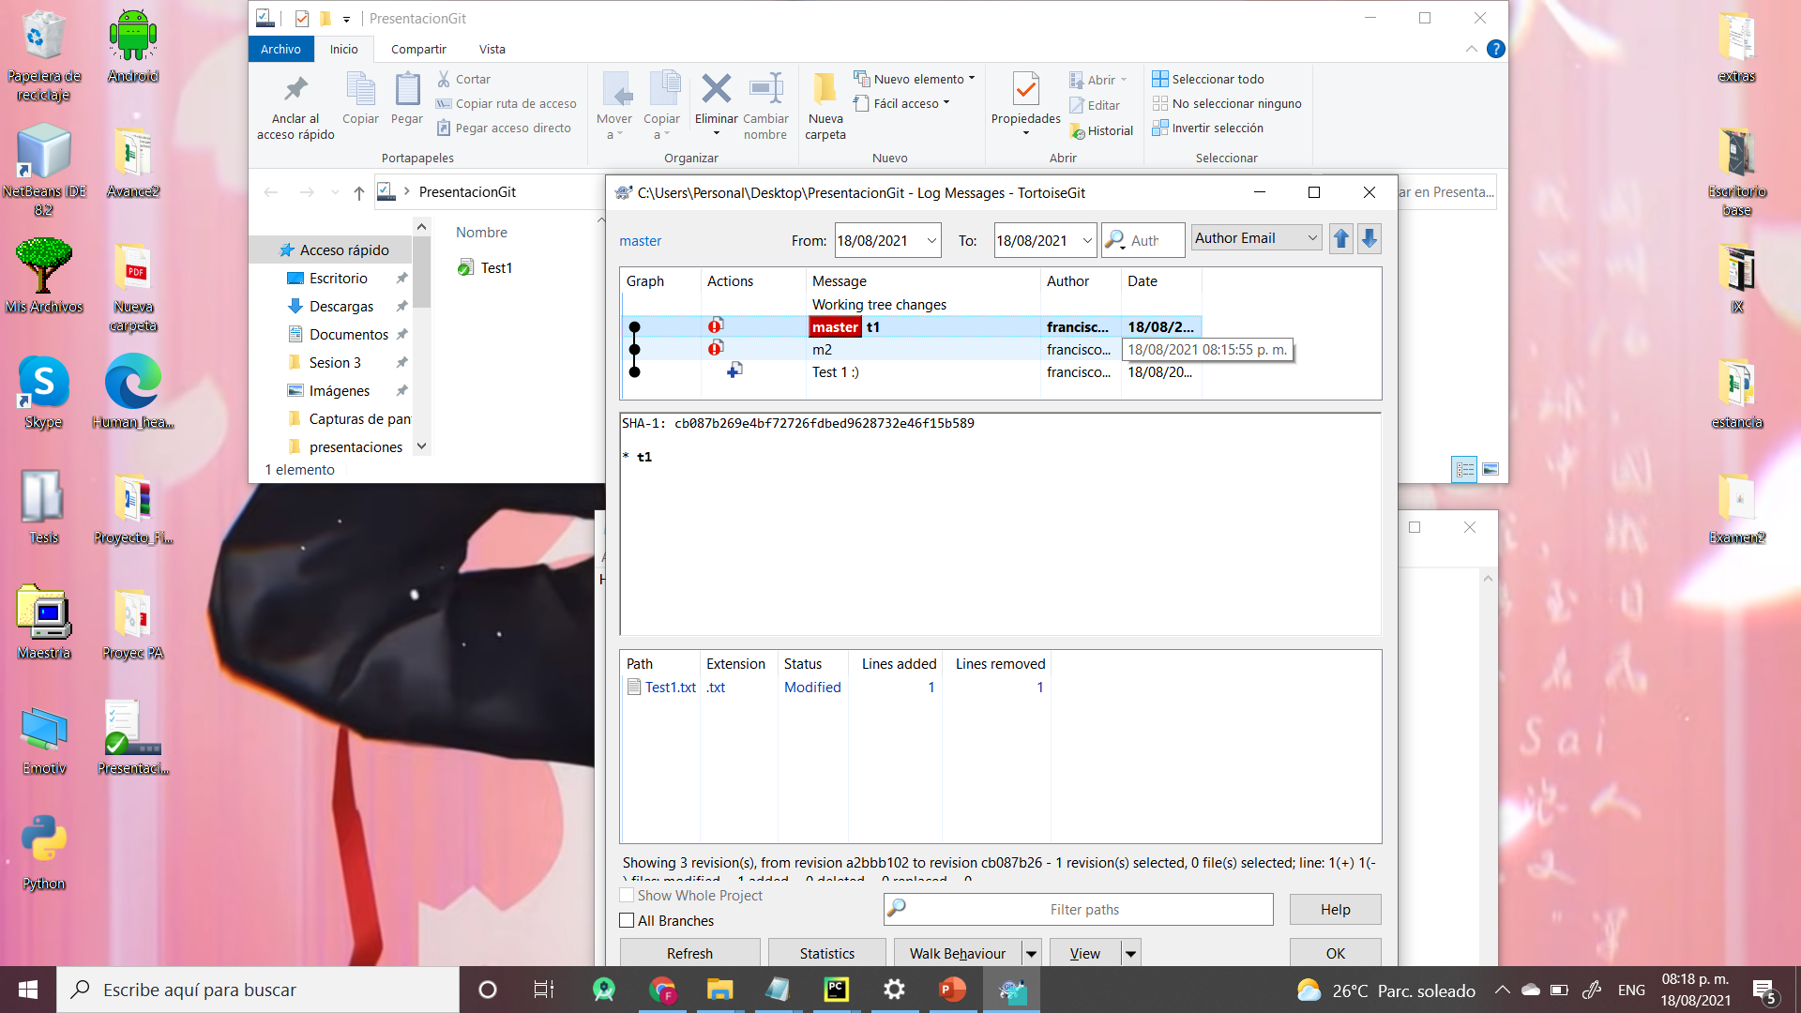
View modification history

Slide 11
References

